Slide 1
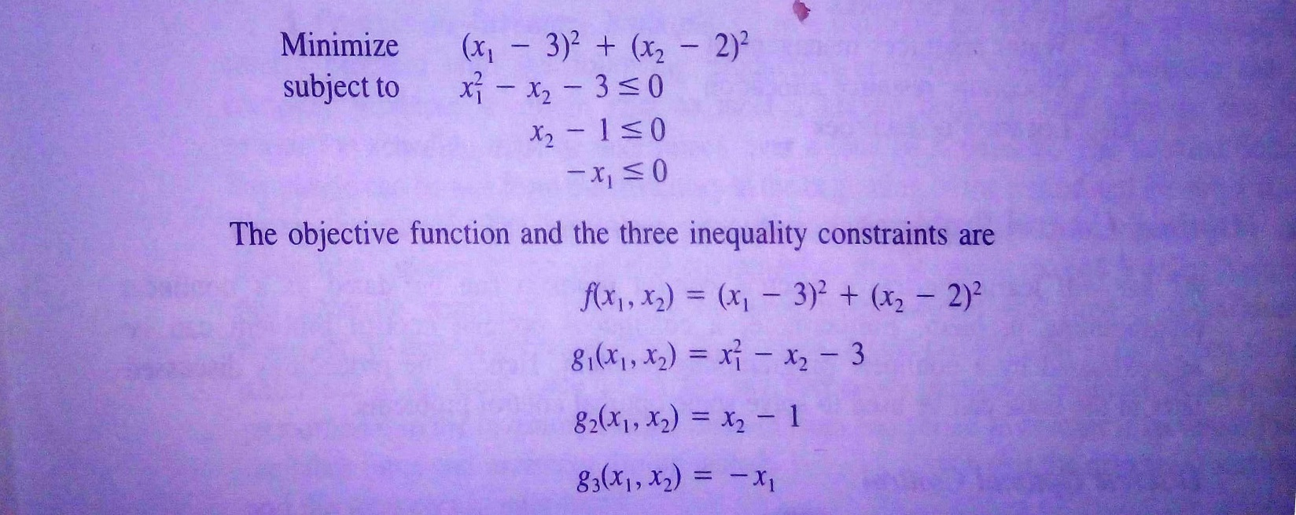

Slide 2
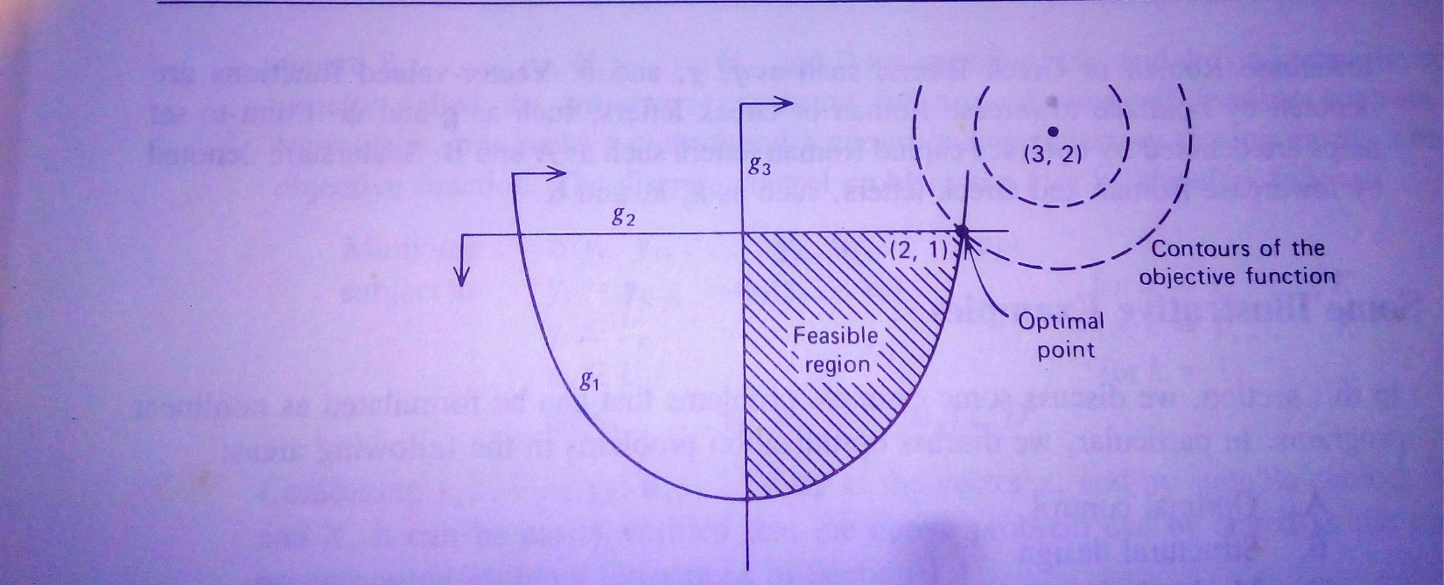

Slide 3
Newton’s Method-Algorithm
Initialization: Determine a reasonably good estimate for the maxima or the minima of the function .
Step 1. Determine and .
Step 2. Substitute (initial estimate for the first iteration) and into
to determine and the function value in iteration i.
Step 3.If the value of the first derivative of the function is zero then you have reached the optimum (maxima or minima). Otherwise, repeat Step 2 with the new value of

Slide 4
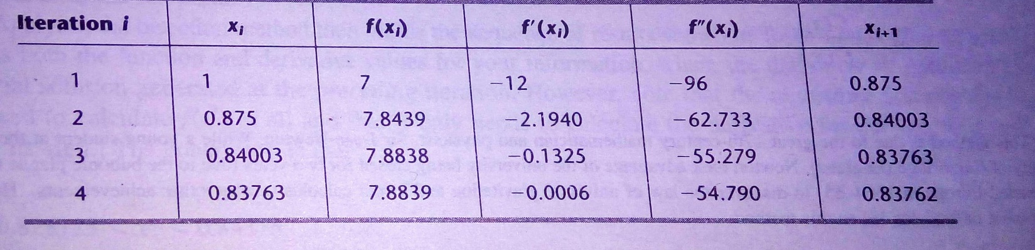

Slide 5
Newton’s Method in Multiple Dimensions
Replace 1st derivative with gradient, 2nd derivative with Hessian

Slide 6
Newton’s Method in Multiple Dimensions
Replace 1st derivative with gradient, 2nd derivative with Hessian
So,
Tends to be extremely fragile unless function very smooth and starting close to minimum

Slide 7
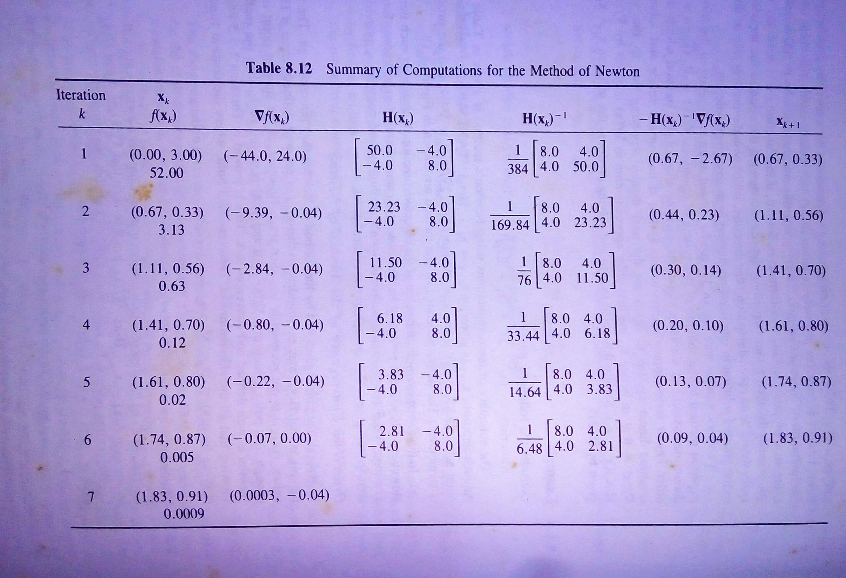

Slide 8
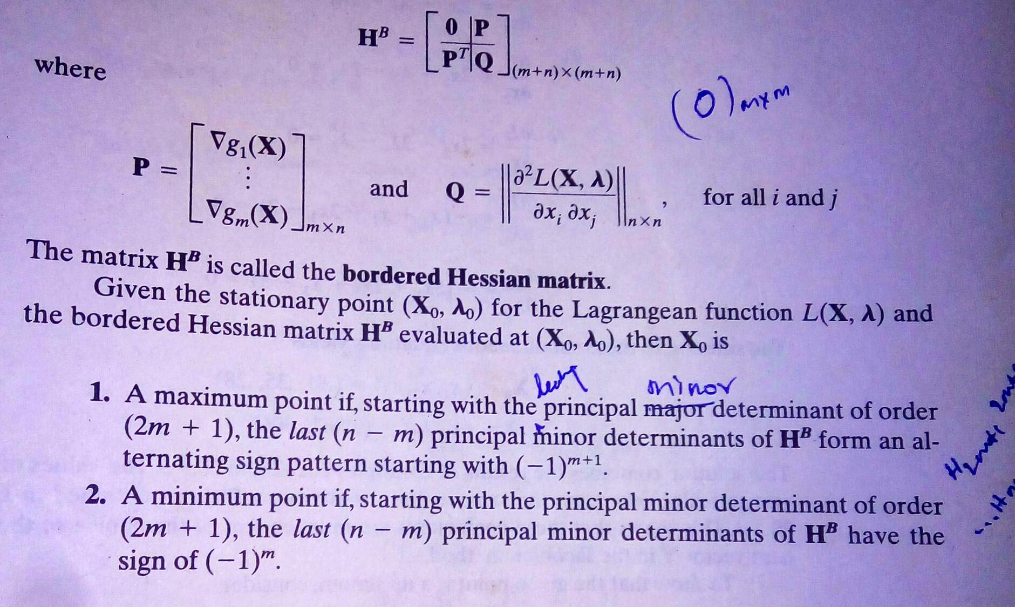

Slide 9
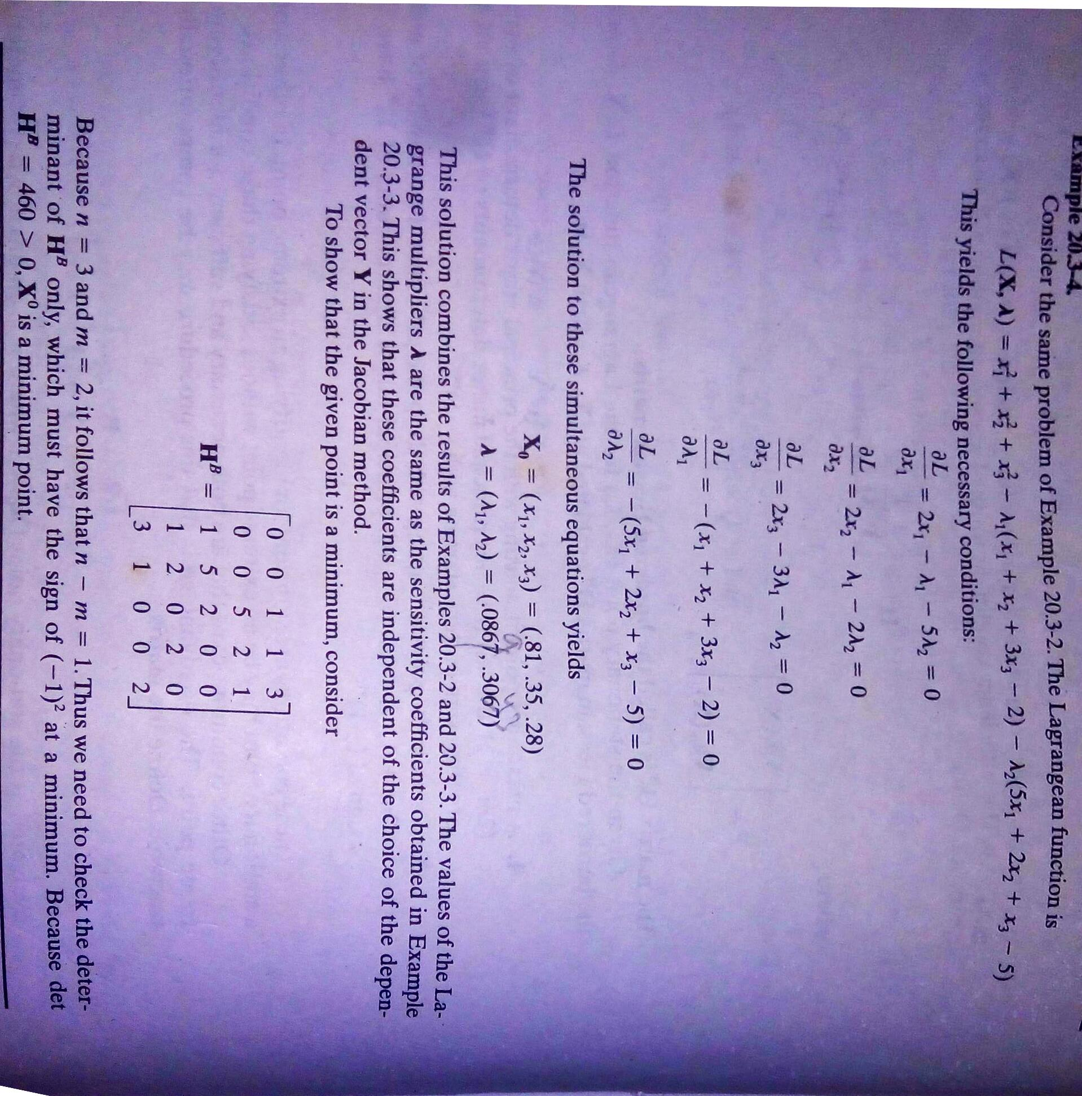

Slide 10


Slide 11


Slide 12


Slide 13
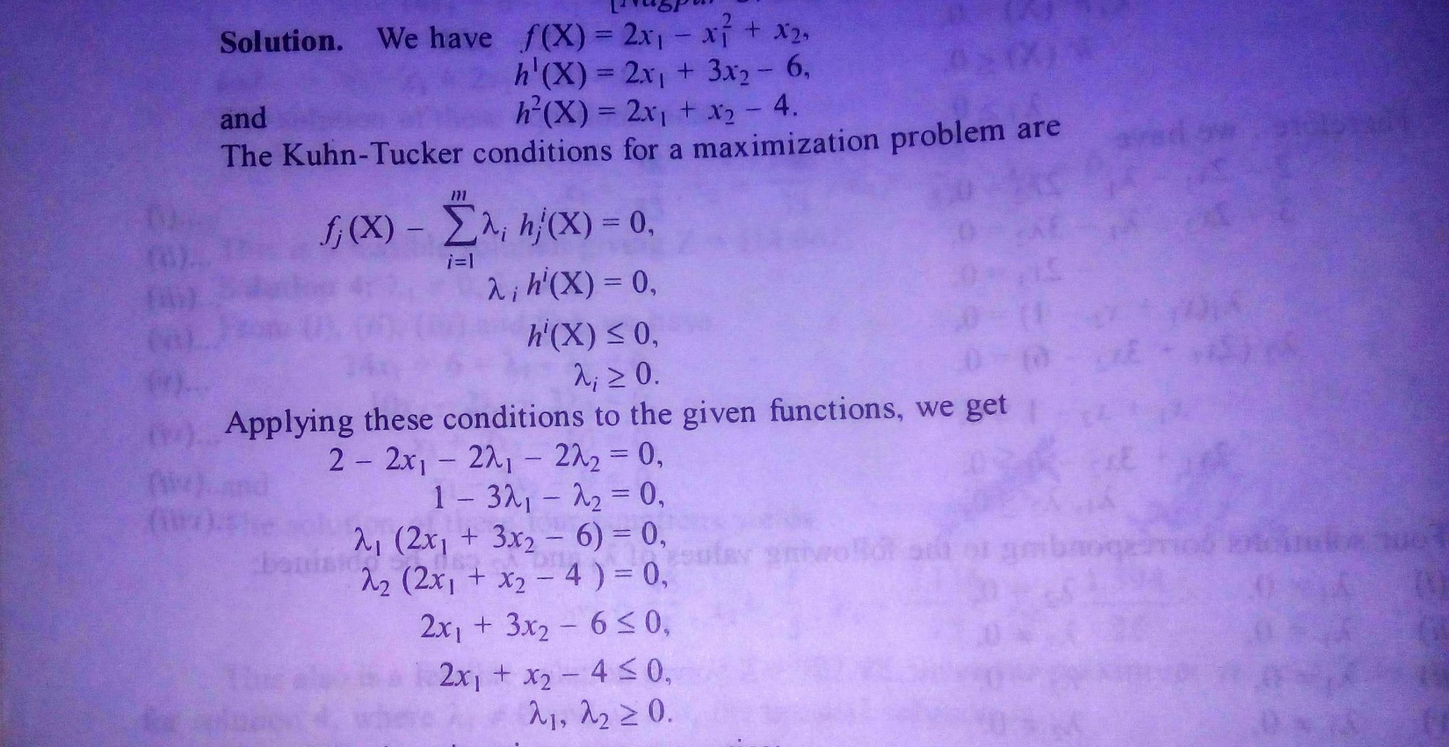

Slide 14
